Slide 1
DB Schema Guide

Slide 2
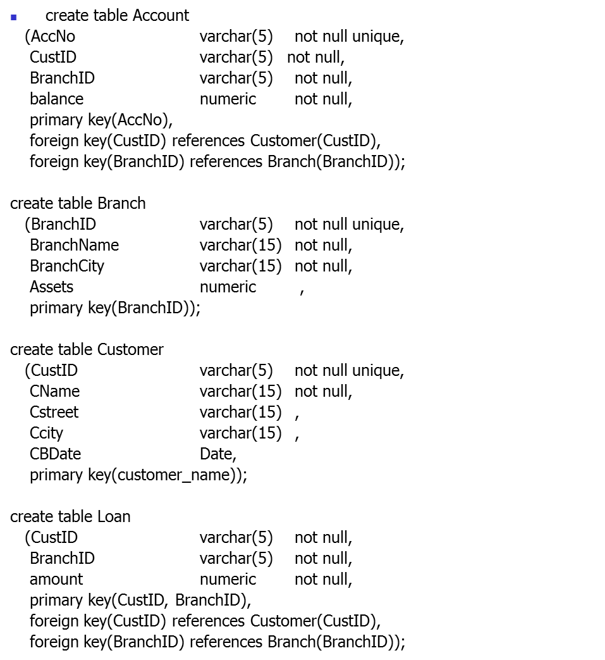

Slide 3
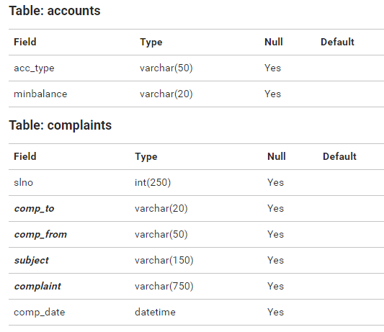

Slide 4
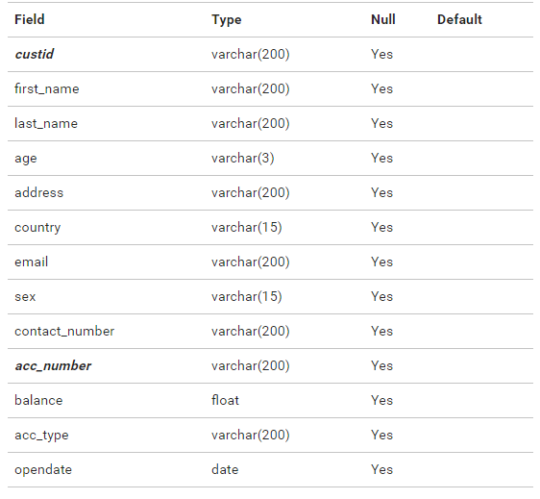
Table: customer

Slide 5
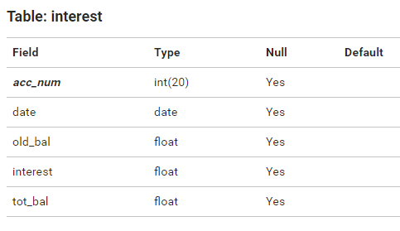

Slide 6
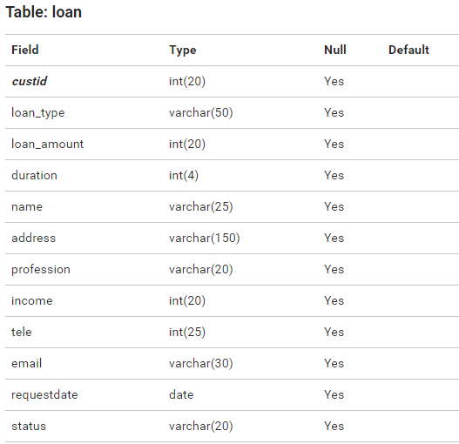

Slide 7
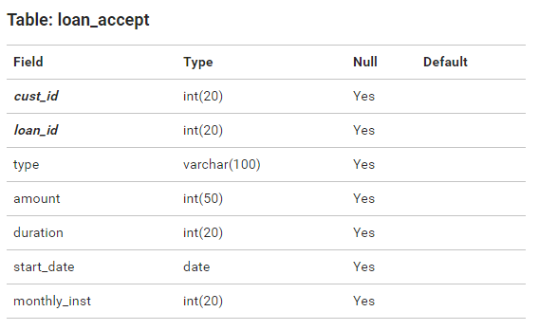

Slide 8
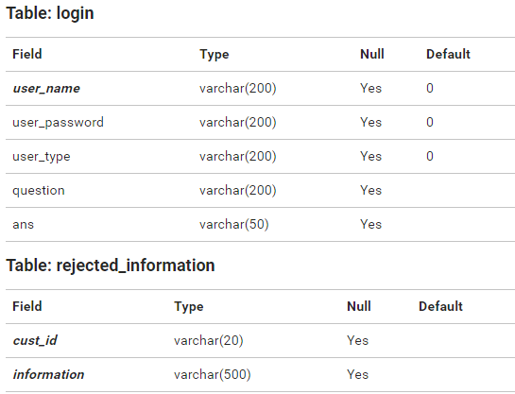

Slide 9
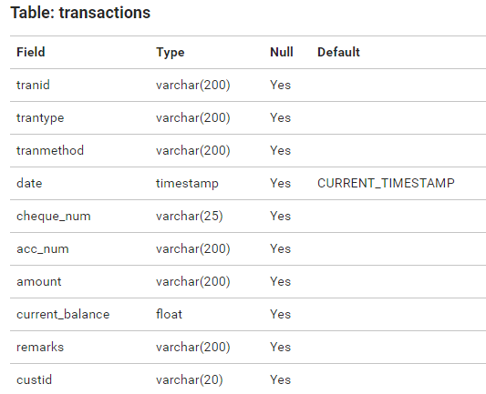

Slide 10
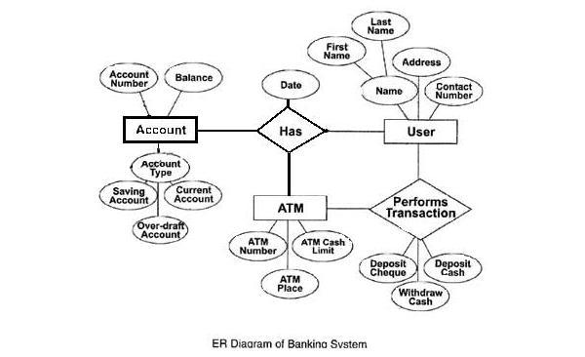

Slide 11
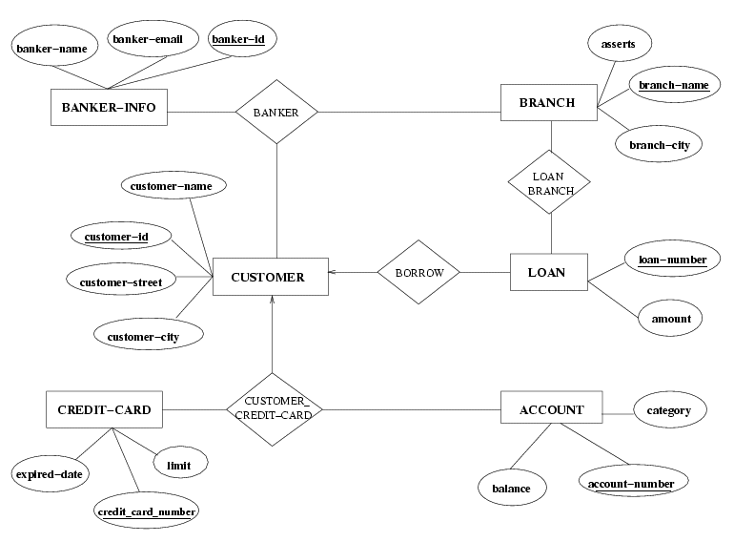

Slide 12
SQL Cod
CREATE TABLE service_category1
(cat_id NUMBER(2) CONSTRAINT cat_pk1 PRIMARY KEY,
cat_type VARCHAR2(25),
cat_desc VARCHAR2(75));
CREATE TABLE service_category4
(cat_id NUMBER(2),
cat_type VARCHAR2(25)
check (cat_type in ('OS', 'Mouse'))
);

Slide 13
Keys
CREATE TABLE d_Account
(account_id NUMBER(2) primary key,
name VARCHAR2(25),
bank VARCHAR2(75));
CREATE TABLE d_Ttan
(account_id NUMBER(2) references d_Account(account_id) ,
acctype VARCHAR2(25)not null,
amount number(38));

Slide 14
https://docs.oracle.com/cd/E19253-01/817-6089/mg_appendixA.html#wp17385

